Slide 1

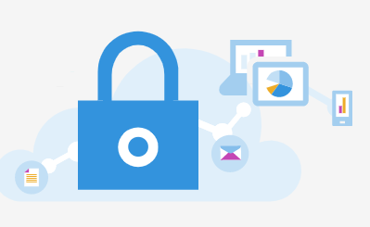
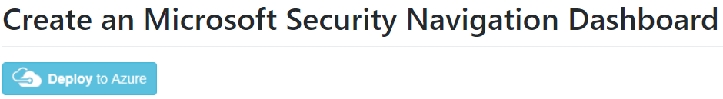
Portal URLs
Azure Sentinel (SIEM + SOAR)
Azure Active Directory Identity Protection
(AADIP)
Microsoft Defender for Office 365
Office 365 Advanced Threat Protection
(O365 ATP)
Microsoft Cloud App Security
(MCAS)
(CASB)
Azure Defender
Azure Security Center
(ASC)
Microsoft Defender for Identity
Azure Advanced Threat Protection
(Azure ATP)
Microsoft Defender Security Center
Microsoft Defender ATP
(MDATP)
Azure Information Protection
(AIP)
Microsoft 365 Security Center
Notes:
Can help with the different portal URLs one may have to navigate through for each Microsoft and Azure Security product. You can also upload a Azure Portal Dashboard here: https://github.com/swiftsolves-msft/dashboards/tree/master/MicrosoftSecurityNavigation
Changes Occurring: 9/22/2020
https://www.microsoft.com/security/blog/?p=91813
Portal Docs: https://docs.microsoft.com/en-us/microsoft-365/security/mtp/portals?view=o365-worldwide

Slide 2



















Free Logs and Alerts
Azure Sentinel (SIEM + SOAR)
ALERTS
ALERTS
LOGS
LOGS
Microsoft 365 Security Center
Azure Security Center
AAD
3rd party data sources
O365
Azure
Cloud Security Posture Management (CSPM)
Azure Defender
(CWPP)
EXO
SPO
OD4B
Teams
Activity Logs
SignIns
Audits
Amazon Web Services
Identities
Endpoints
Data & Email
Cloud Apps
Azure Active Directory Identity Protection
(AADIP)
Cisco, PaloAlto, Fortinet, Checkpoint
PaaS Audit
Microsoft Defender for Endpoint
(MDATP)
Microsoft Defender for O365
(O365 ATP)
Microsoft Cloud App Security
(MCAS)
(CASB)
Symantec, Carbon Black, CrowdStrike,
Cyber Ark
Microsoft Defender for Identity
(Azure ATP)
Microsoft Defender
365
(MDATP)
(Threat Hunting)
Microsoft Cloud App Security
(MCAS)
(CASB)
Custom Logs _CL
Microsoft Cloud App Security
(MCAS)
(CASB)
Azure Information Protection
(AIP)
Notes:
Walk through and explain what alerts are Free (Left Side) and what Raw Logs are Free (Right side)

Slide 3
Azure Sentinel
Pricing sheet - Rudnei Oliveira
Ver 0.1
^{8/2nd}

Slide 4

Ingestion examples:
No Cost with Log/Alert ingestion:
O365 Activity logs
Azure Activity logs
Azure Security Center Alerts
Azure DDoS and WAF Alerts
Defender ATP Alerts
Azure ATP Alerts
Office ATP Alerts
Identity Protection Alerts
MCAS Security Alerts
* This list may change without notification.
$
Azure Sentinel
Pricing sheet
(VM cost)
$
Palo Alto
(cost per GB ingested)
Syslog / CEF Gw
(VM)
Cisco
$
Threat Intel
$
(all costs involved)
MDATP
Azure
O365
Sentinel Features:
Costs:
VM
Depends on the data ingested by the connector
$
Data Connector
VM
$
(cost per GB ingested)
Analytic Queries
No Cost
VM
Just in case you have those data ingested.
Log Analytics
(workspace)
Diag
Logs
(others)
Azure Sentinel
Hunting Queries
No Cost
Workbooks
No Cost
Notebooks
$
Notebook usage cost
On-premises
$
Playbooks
Logic App cost
VM
$
(cost per GB ingested)
Official Pricing References:
Azure Sentinel - https://azure.microsoft.com/en-us/pricing/details/azure-sentinel/
Log Analytics - https://azure.microsoft.com/en-us/pricing/details/monitor/
Logic Apps - https://azure.microsoft.com/en-us/pricing/details/logic-apps/
VM - https://azure.microsoft.com/en-us/pricing/details/virtual-machines/linux/
Notebooks - https://docs.microsoft.com/en-us/azure/notebooks/azure-notebooks-overview#pricing-and-quotas
VM
Just in case you have those data ingested.
VM
* This is not an official pricing reference. Azure Sentinel official pricing page (link above) is the most accurate information.

